Slide 1

Design of Circular and Rectangular Patch Antennas Using Teflon and Rogers Substrates for 5G Applications at 25 GHz
SESHADRI RAO GUDLAVALLERU ENGINEERING COLLEGE
(An Autonomous Institute with Permanent Affiliation to JNTUK, Kakinada)
Seshadri Rao Knowledge Village Gudlavalleru-521356
Department of Electronics and communication Engineering
Team Members:--
T. Ashok (20481A04M8)
G. Rajesh (20481A04J6)
S. Vamsi (20481A04K2)
S. Sneha Sowjanya (20481A04M1)
Dr. Y. Rama Krishna
M.Tech., Ph.D.,
Professor and Mentor
Project Guide

Slide 2
Objective
This project aims to design circular and rectangular patch antennas optimized for 5G applications operating at 25 GHz. By utilizing Teflon and Rogers substrates, our goal is to achieve superior performance in key parameters such as impedance matching, bandwidth, and radiation characteristics. Through systematic simulation and optimization, we seek to develop innovative antenna designs tailored specifically for the demands of 5G communication systems. Ultimately, this project endeavors to contribute to the advancement of high-frequency antenna technology, meeting the evolving needs of modern wireless networks efficiently and effectively.

Slide 3
Abstract
Focusing on the development of circular and rectangular patch antennas for 5G applications at 25 GHz, this project explores the use of Teflon and Rogers substrates to enhance antenna performance. By leveraging advanced simulation tools and optimization techniques, we aim to optimize key parameters including impedance matching, bandwidth, and radiation efficiency. The outcomes of this project are expected to address the increasing demand for high-performance antennas in next-generation wireless communication systems. Through innovative design approaches, we anticipate contributing significantly to the advancement of efficient and reliable antennas for 5G networks, facilitating the evolution of wireless communication technology

Slide 4
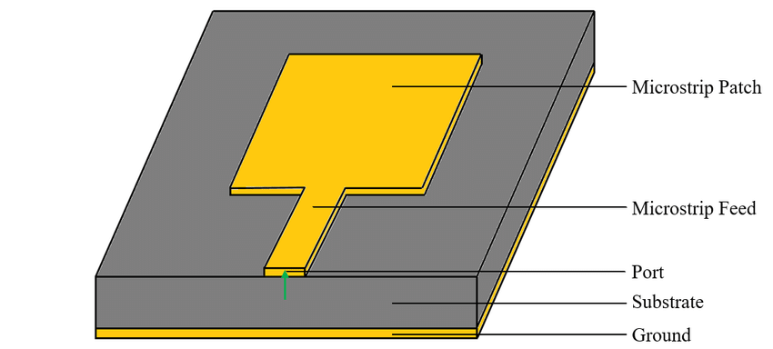
Implementation Diagram :
Fig.1 : General diagram of Micro Strip Patch Antenna

Slide 5
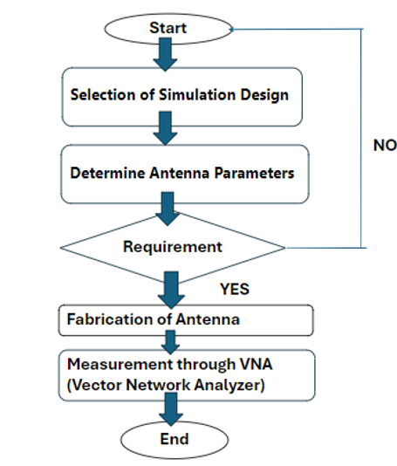
Microstrip Patch Antenna Design :
Fig.2 : Flow Chart for Microstrip Patch Antenna Design

Slide 6

Software Details:

Slide 7
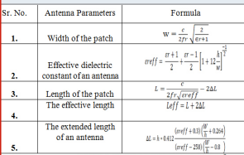
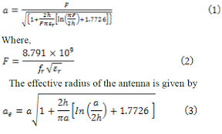
Design Equations for Micro Strip Patch Antenna :
Rectangular Patch Antenna
Circular Patch Antenna

Slide 8
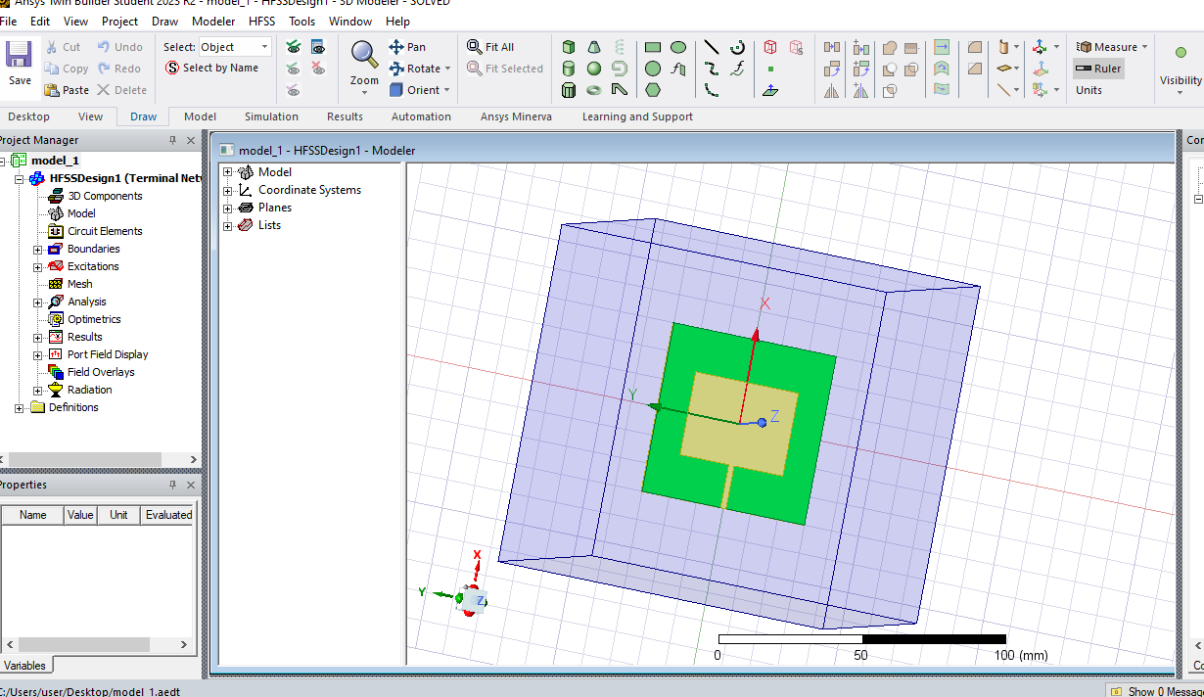
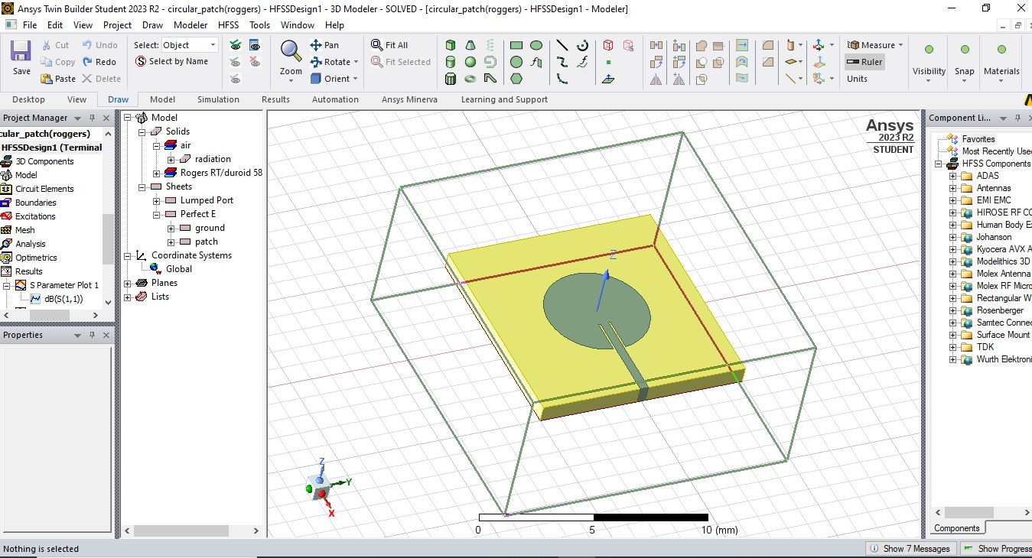
Microstrip Patch Antenna Design
Fig. 3a Rectangular Patch Antenna Design
Fig. 3b Circular Patch Antenna Design

Slide 9
Antenna Design Parameters and Specifications
Antenna Type | Permittivity | Operating Frequency (GHz) | Patch Dimensions (mm) | Feed Dimensions (mm) | Substrate Dimensions (mm)
Rectangular (Rogers 4003) | 3.55 | 34.5 | 2.76 x 3.97 x 0 | 3 x 0.3 | 6 x 6 x 0.8
Rectangular (Teflon) | 2.1 | 23.8 | 3.57 x 4.82 x 0 | 3 x 0.3 | 6 x 6 x 0.8
Circular (Teflon) | 2.1 | 21.85 | Radius: 2.4 | 5 x 0.4 | 10 x 10 x 0.8
Circular (Rogers RT/Duroid 5880) | 2.2 | 20.85 | Radius: 2.4 | 5 x 0.4 | 10 x 10 x 0.8

Slide 10
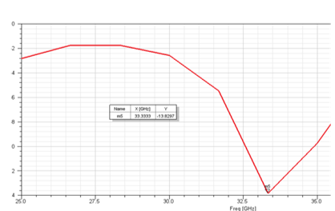
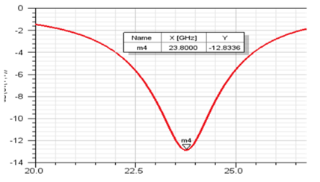
Simulation Results :
1. S Parameter (Return Loss)
Fig. 4a : S Parameter (Teflon) of
Rectangular Patch Design
Fig. 4b : S Parameter (Rogers 4003) of
Rectangular Patch Design

Slide 11
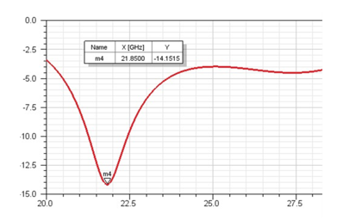
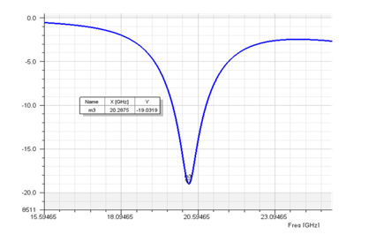
Fig. 5a : S Parameter (Teflon) of
Circular Patch Design
Fig. 5b : S Parameter (Rogers RT/Duroid 5880) of Circular Patch Design

Slide 12
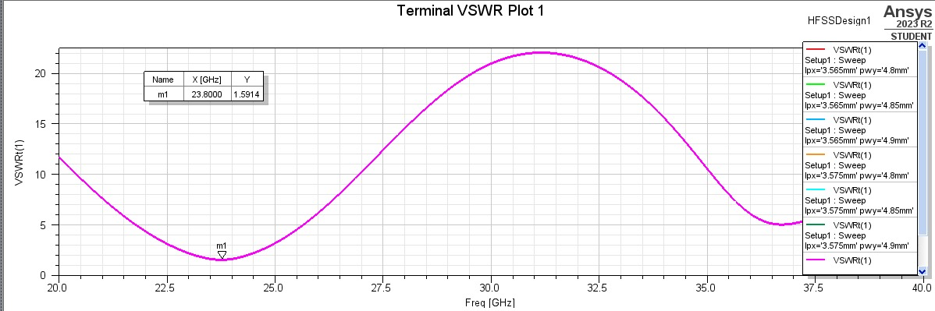
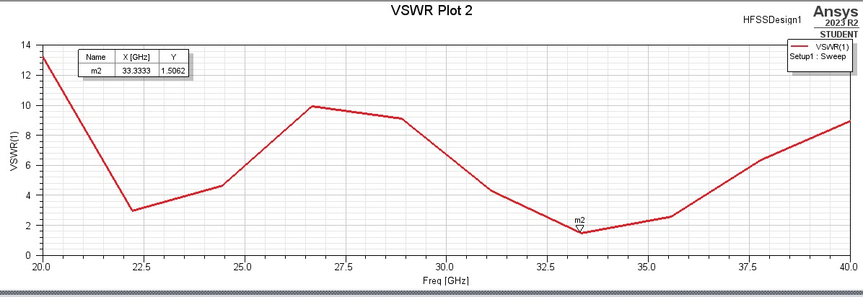
2. Voltage Standing Wave Ratio (VSWR)
Fig. 6a : VSWR (Teflon) of Rectangular Patch Antenna Design
Fig. 6b : VSWR (Rogers 4003) of
Rectangular Patch Antenna Design

Slide 13
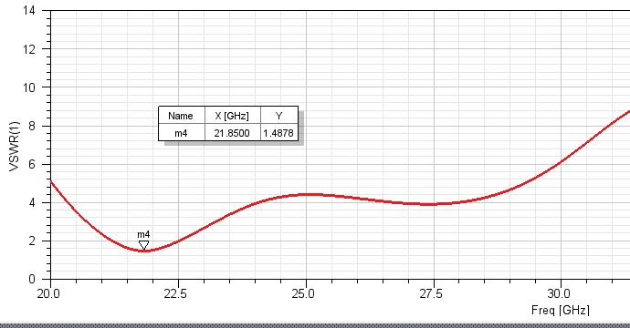
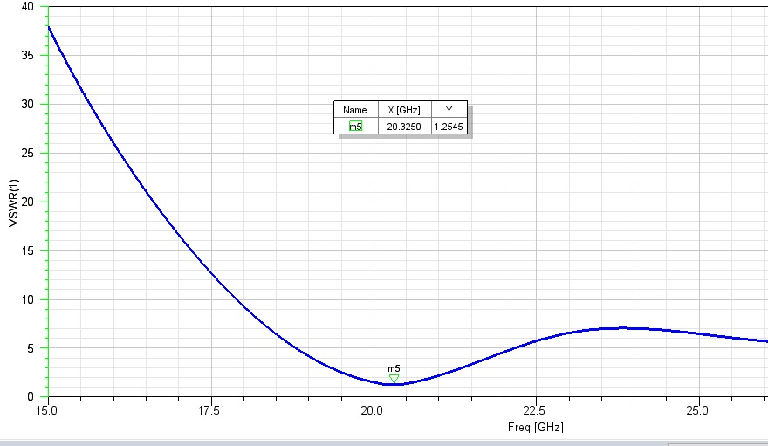
Fig. 7a : VSWR (Teflon) of Circular Patch Antenna Design
Fig. 7b : VSWR (Rogers RT/Duroid 5880) of Circular Patch Antenna Design

Slide 14
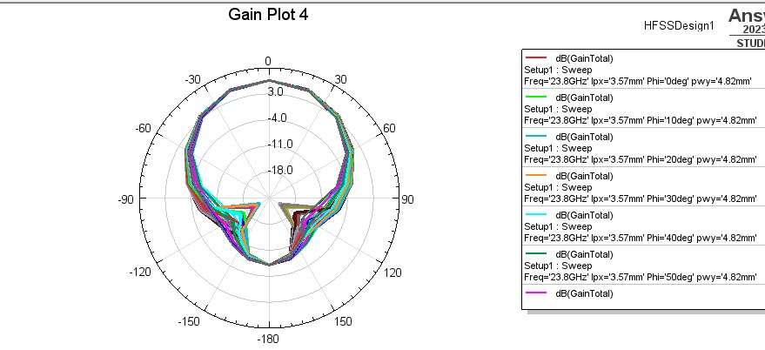
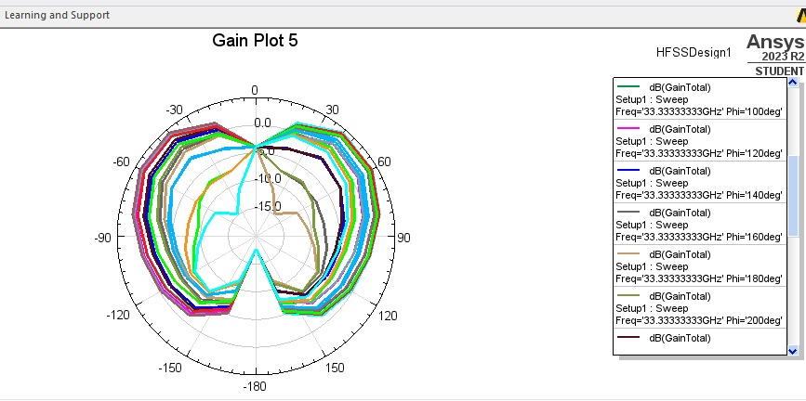
3. Gain Plots
Fig. 8a : Gain Plot of Teflon Rectangular Patch Antenna Design
Fig. 8b : Gain plot of Rogers 4003 Rectangular Patch Antenna Design

Slide 15
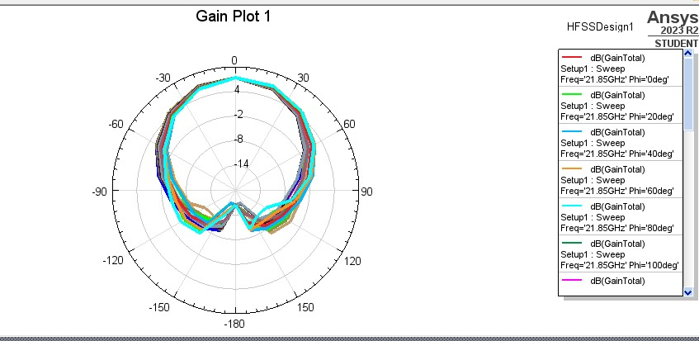
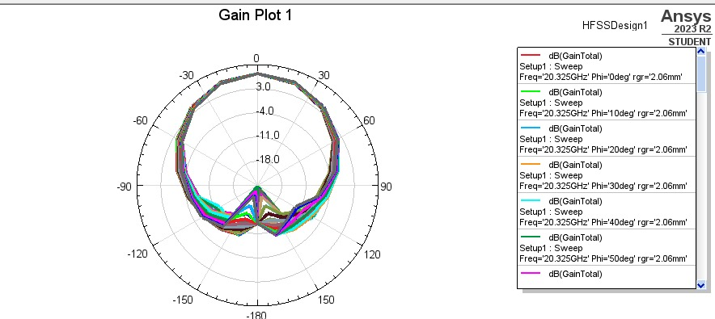
Fig. 9a: Gain Plot of Teflon Circular
Patch Antenna Design
Fig. 9b: Gain plot of Rogers RT/Duroid 5880 Circular Patch Antenna Design

Slide 16
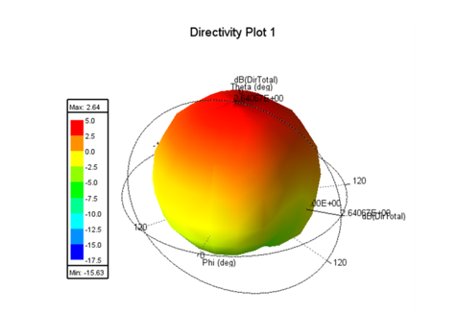
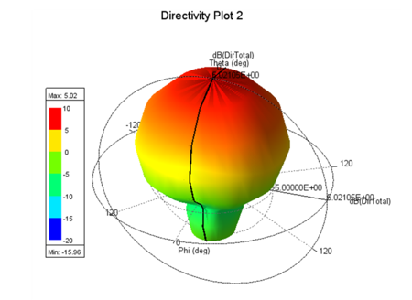
4. Directivity Plots
Fig. 10a: Directivity Plot of Teflon Rectangular
Patch Antenna Design
Fig. 10b: Directivity Plot of Rogers 4003 Rectangular Patch Antenna Design

Slide 17
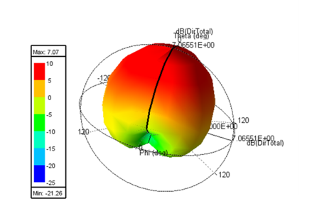
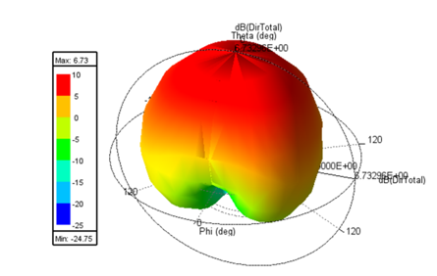
Fig. 11a: Directivity Plot of Teflon Circular
Patch Antenna Design
Fig. 11b: Directivity Plot of RT/Duroid Circular
Patch Antenna Design

Slide 18
Comparison Antenna Parameters at 25 GHZ
Antenna Type | S-parameter (dB) | VSWR | Peak Directivity | Peak Gain | Total Efficiency | Radiation Efficiency | Bandwidth
Circular (Teflon) | -14.06 | 1.487 | 5.569213 | 5.443 | 0.939920 | 0.977501 | 1.25 GHz
Circular (Rogers RT/Duroid) | -19.03 | 1.25 | 5.579727 | 5.4776 | 0.969431 | 0.981699 | 1.05 GHz
Rectangular (Teflon) | -13.9 | 1.58 | 4.491314 | 4.6183 | 0.882649 | 1.028291 | 1.0 GHz
Rectangular (Rogers 4003) | -12.8 | 1.54 | 0.565728 | 0.5642 | 0.927480 | 0.997434 | 2.3 GHz

Slide 19
Advantages:
Performance Optimization
Feasibility Validation
Global Acceptance
Cost-Efficiency
Compact Design
Versatility
Ease of Integration
Reliability and Durability

Slide 20
Applications:
Satellite Communication.
Radar Systems
Wireless Networks
Microwave Imaging
High-Speed Wireless Networks
Défense Systems
Automotive Communication

Slide 21
Reference Papers:
Z. Ding, D. Zhang, and C. Ma, (2020) Broadband Antenna Design with Integrated CB-CPW and Parasitic Patch Structure for WLAN, RFID, Wimax, and 5G Applications,” IEEE Access, vol. 8, pp. 42877–42883.
Touko, Borel & Priyadarshini, Rashmi. (2023). A Microstrip Patch Antenna Designed for 25 GHz Applications. 10. 134-139.
Khan, Imran and D., Geetha and Gunjal, Raksha and Rashmitha, Rashmitha, Review of MSP Antenna Design for Various Substrates (August 14, 2018). Available at SSRN: https://ssrn.com/abstract=3230632 or http://dx.doi.org/10.2139/ssrn.3230632
Thater A, Khade S, Lande VS (2021) A modified rectangular mid-band microstrip antenna for WLAN, Wi-Fi and 5G applications. J Univ Shanghai Sci Tech-no 23:1–6
S. E. Didi, I. Halkhams, M. Fattah, Y. Balboul, S. Mazer, and M. E. Bekkali, ‘‘Design of a microstrip antenna patch with a rectangular slot for 5G applications operating at 28 GHz,’ TELKOMNIKA (Telecommunication Computing Electronics and Control), vol. 20, no. 3, pp. 527-536, 2022, doi: 10.12928/telkomnika; v20i3.23159.

